Slide 1
Introduction to Transformer
Quang Duong

Slide 3
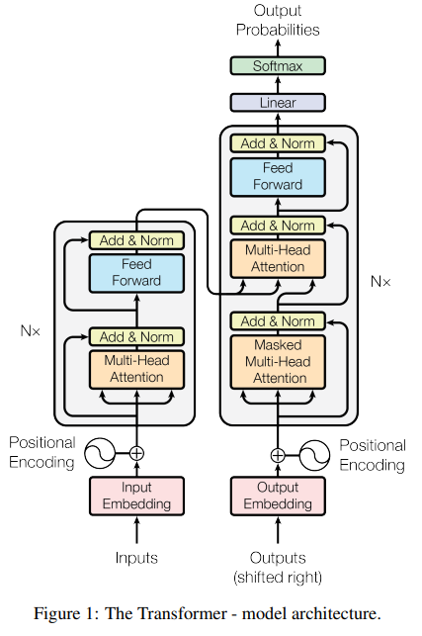
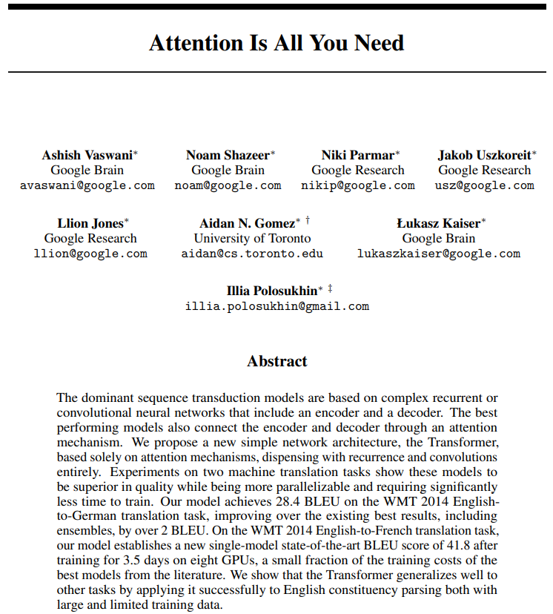
Transformer
Attention Is All You Need, A. Vaswani et al, 2017, https://arxiv.org/abs/1706.03762

Slide 4
NLP until 2017
Recurrent Neural Networks
Long Short-Term Memory (LSTM) networks
Gated Recurrent Units (GRU)
2017

Slide 5
NLP until 2017
Recurrent Neural Networks (RNNs)
Long Short-Term Memory (LSTM) networks
Gated Recurrent Units (GRU)
2017
Some advantages of RNNs (among others)
Efficient handling of sequential data types such as text, speech, and time series.
Ability to process inputs of variable lengths, a feature lacking in feedforward neural networks.
Enhanced training efficiency due to weight sharing across different time steps.

Slide 6
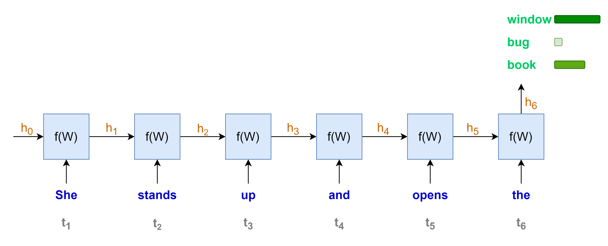
Language modeling with RNNs
“She stands up and opens the …………..”
Some disadvantages of RNNs (among others)
Sequential computation, one word at a time
→ Less rooms for parallel computation
→ Longer sequence, longer computation time

Slide 7
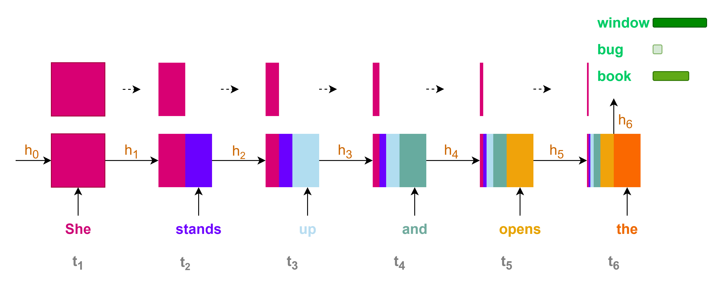
Language modeling with RNNs
Some disadvantages of RNNs (among others)
Contributions of initial states or information to the final state or prediction are very small for long sequence context
→ Loss of information for long-range dependencies

Slide 8
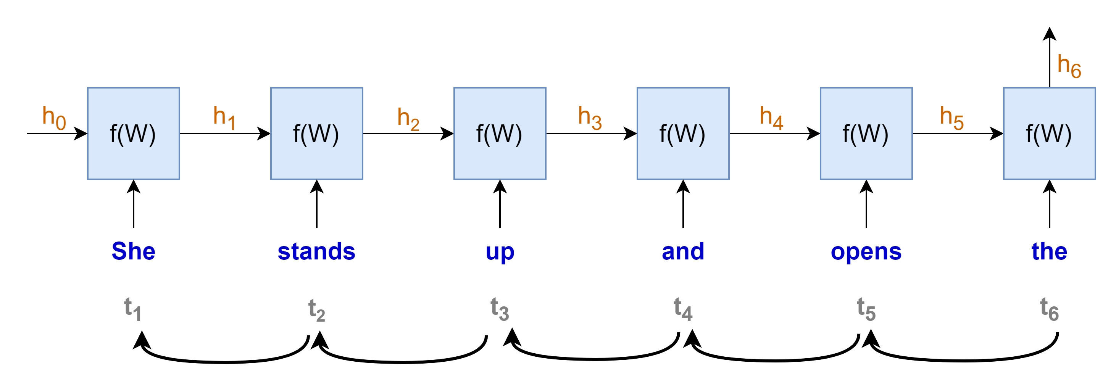
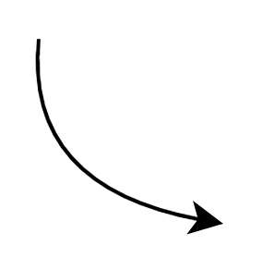
















Language modeling with RNNs
$$gradient products$$
$$\frac{∂h_{t}}{∂h_{t−1}}≪1 →very small→"vanished"$$
$$\frac{∂h_{t}}{∂h_{t−1}}≫1 →very large→"exploded"$$
$$\frac{∂h_{1}}{∂W}$$
$$\frac{∂h_{2}}{∂h_{1}}$$
$$\frac{∂h_{3}}{∂h_{2}}$$
$$\frac{∂h_{4}}{∂h_{3}}$$
$$\frac{∂h_{5}}{∂h_{4}}$$
$$\frac{∂h_{6}}{∂h_{5}}$$
$$×$$
$$×$$
$$×$$
$$×$$
$$×$$
$$\frac{∂L}{∂W}=\frac{∂L}{∂y}\frac{∂y}{∂h_{6}}$$
$$×$$
“chain rule”
Some disadvantages of RNNs (among others)
Training with Backpropagation Through Time
Vanishing or exploding gradients problems
hindering the learning process, especially for long sequences
making the training process highly unstable

Slide 9
NLP until 2017
Recurrent Neural Networks
Long Short-Term Memory (LSTM) networks
Gated Recurrent Units (GRU)
2017
Some disadvantages of RNNs (among others)
Sequential computation, hard to parallel computation with GPU
Loss of information for long-term dependencies
Vanishing or exploding gradient problems

Slide 10
The arrival of Transformer
2017
Recurrent Neural Networks
Long Short-Term Memory (LSTM) networks
Gated Recurrent Units (GRU)
Transformer
Some disadvantages of RNN
(among others)
Sequential computation, hard to parallel computation with GPU
Loss of information for long-term dependencies
Vanishing or exploding gradient problems

Slide 11


Transformer for lingual translation
Prediction:
"Je vais bien"
Transformer
Decoder
Encoder
Source:
"I am fine"
Simplified transformer architecture

Slide 12
The arrival of Transformer
2017
Recurrent Neural Networks
Long Short-Term Memory (LSTM) networks
Gated Recurrent Units (GRU)
Transformer
Some disadvantages of RNN
(among others)
Sequential computation, hard to parallel computation with GPU
Loss of information for long-term dependencies
Vanishing or exploding gradient problems
Transformer with self-attention mechanism
(among others)
Parallel computation → leverage GPU
Capture long-range dependencies
Less prone to vanishing or exploding gradient

Slide 13
NLP revolutions since 2017
2017
2018
Recurrent Neural Networks
Long Short-Term Memory (LSTM) networks
Gated Recurrent Units (GRU)
Transformer
Pre-trained language models
BERT
GPT
T5
PaLM
Llama
Mistral
Phi
Falcon
OLMo
…

Slide 15
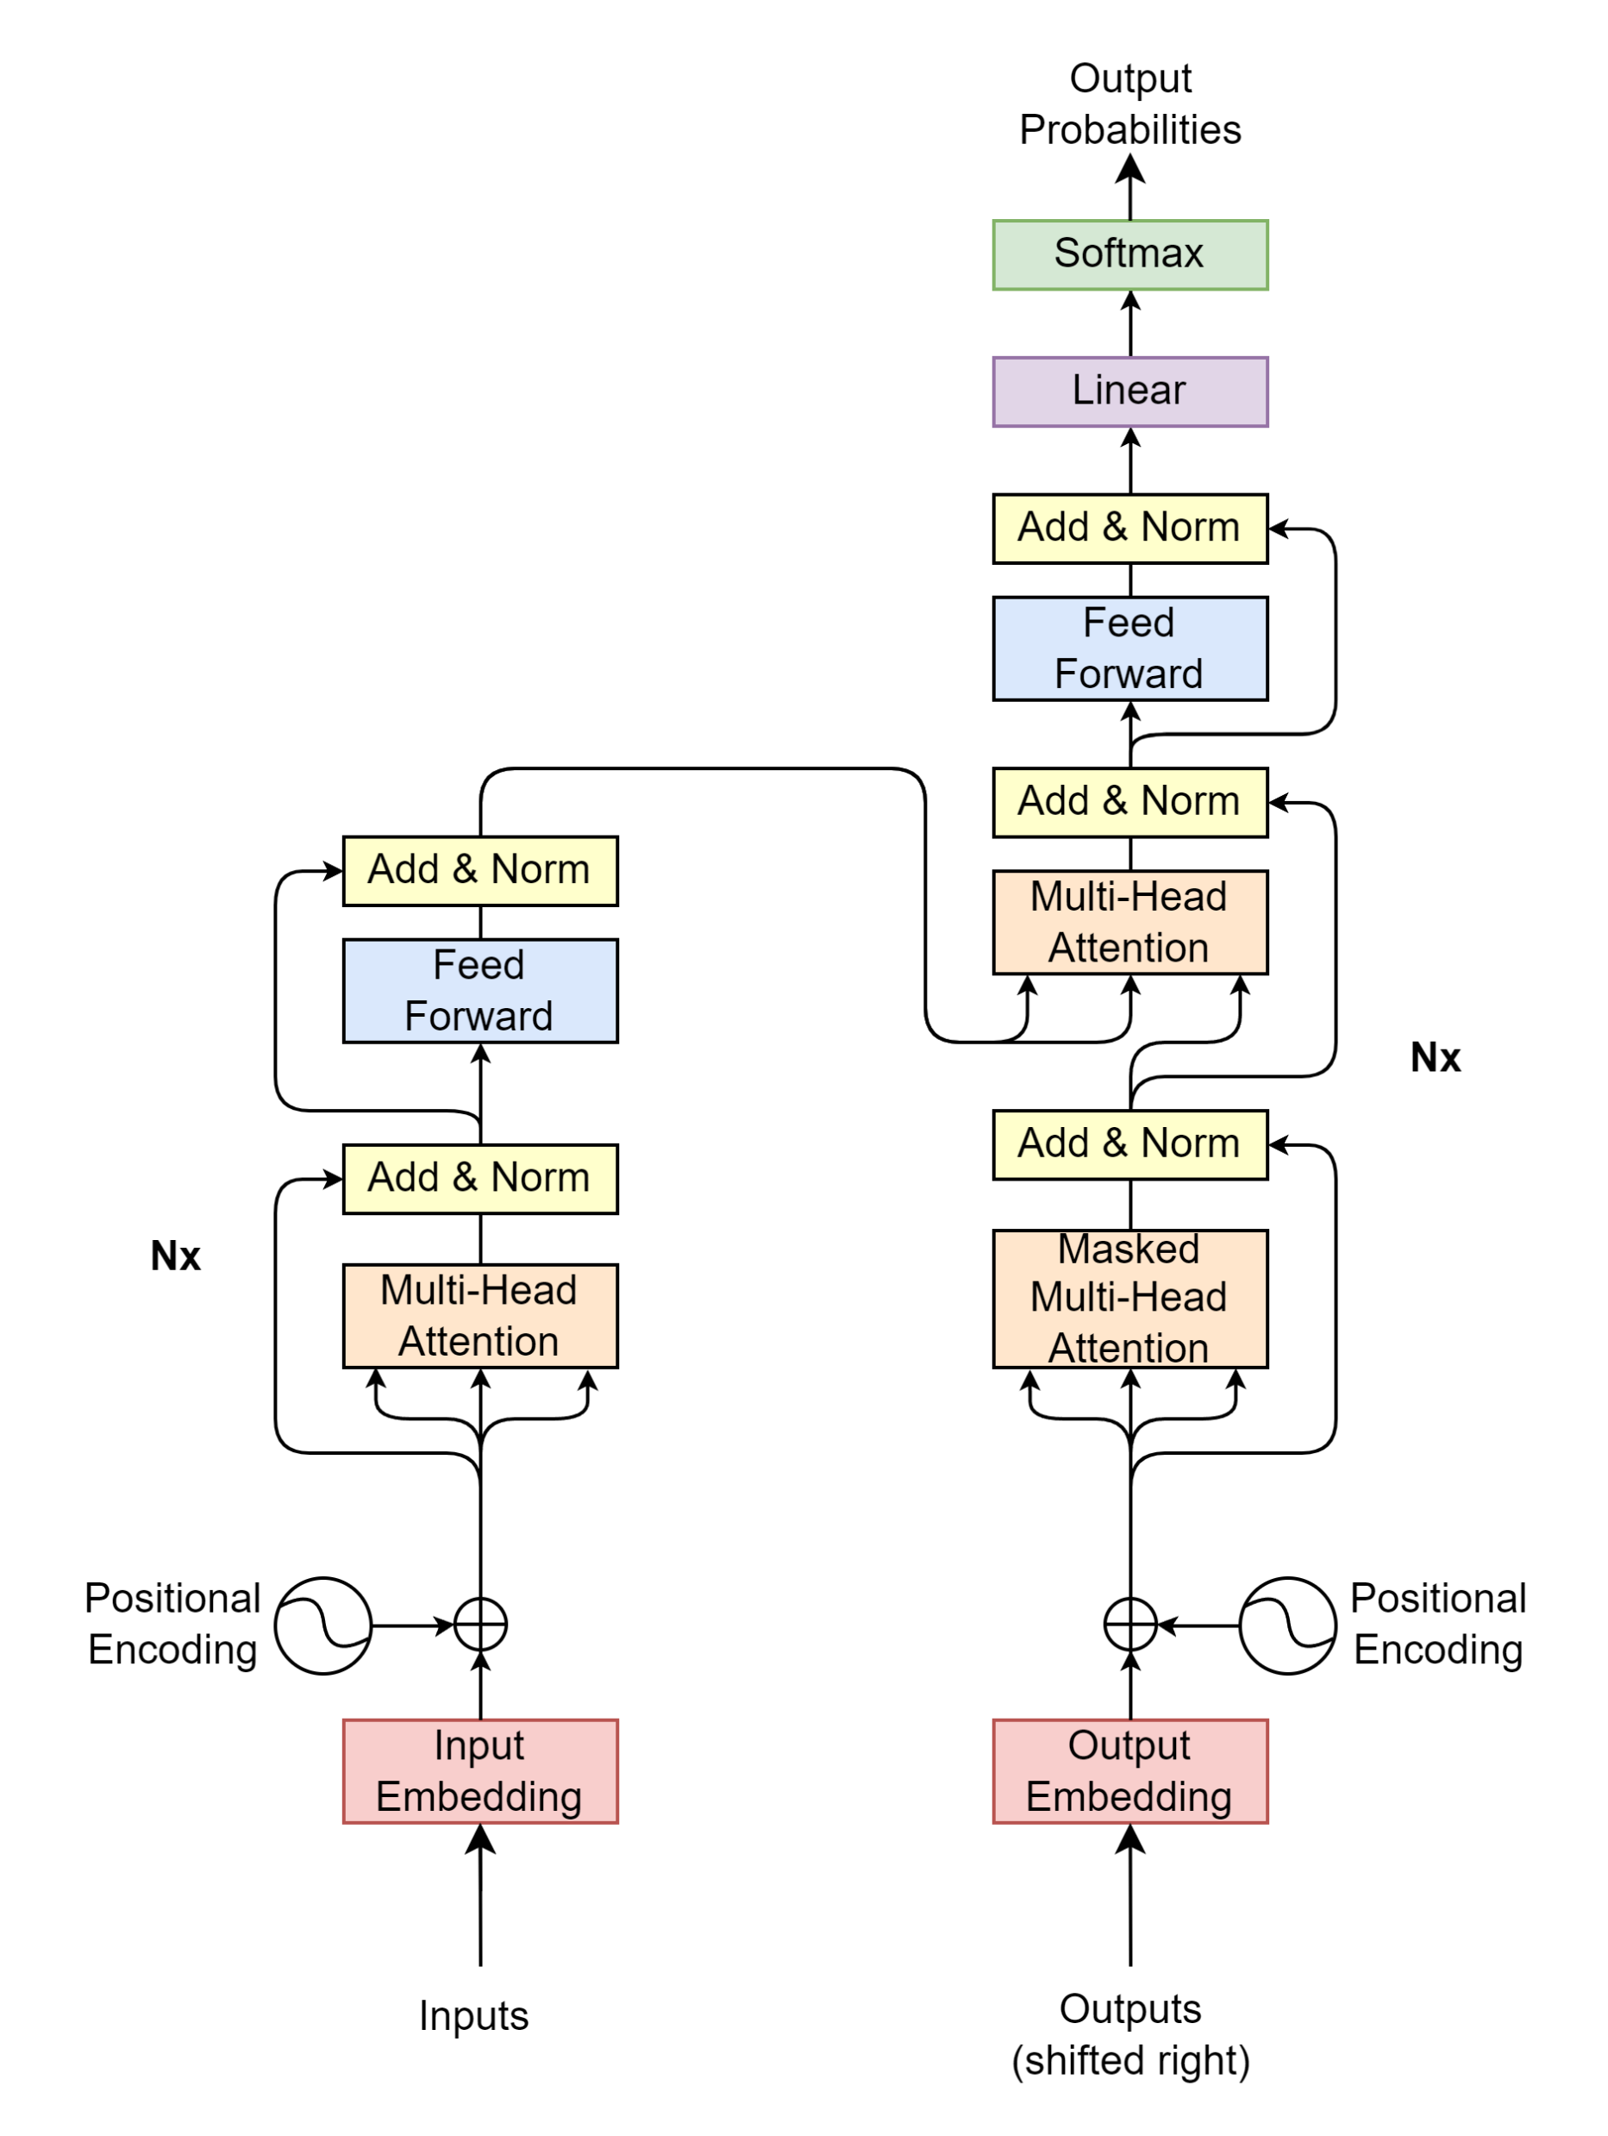

Transformer – Plan of attacks
Input/output text data
How the model understand text data?
Transformer block-by-block
What are the input-output-process of each block?
What is its meaning?

Slide 17
Inputs/Outputs

Slide 18
Text data → Model
Inputs
Outputs
Source
Target/Label
"I
am
fine"
"Thank
you
very
much"
"Je vais bien"
"Merci beaucoup"

Slide 19
Text data → Model
Inputs
Outputs
Source
Target/Label
Model only understands numerical value
Transform text to numerical representation
Source/target texts may have different lengths
A fixed sequence length is needed for model computation
When to start and to end model’s prediction
→ Find some ways to notify model when to start and to end a sequence
"I
am
fine"
"Thank
you
very
much"
"Je vais bien"
"Merci beaucoup"

Slide 20
Text data → Model
Inputs
Outputs
Source
Target/Label
Model only understands numerical value
Transform text to numerical representation
Source/target texts may have different lengths
A fixed sequence length is needed for model computation
When to start and to end model’s prediction
→ Find some ways to notify model when to start and to end a sequence
"I
am
fine"
"Thank
you
very
much"
"Je vais bien"
"Merci beaucoup"
Tokenizer
2
9
107
550
3
1
1
2
2089
95
75
120
3
1
2
69
600
71
3
1
1
2
3546
324
3
1
1
1

Slide 21
Tokenizer
Contain large vocabulary dictionary
Transform text to numerical representation
Token can be a word or a character
Special tokens
UNK: Unkown
PAD: Padding
SOS: Start Of Sentence
EOS: End Of Sentence
{
…
"vocab": {
"[UNK]": 0,
"[PAD]": 1,
"[SOS]": 2,
"[EOS]": 3,
"I" : 9,
"you": 24,
"very": 75,
"am" : 107,
"much": 120,
"fine": 550,
"French": 582
"cook": 1779,
"Thank": 2089,
}
…
}

Slide 22
Tokenizer
Tokenizer
"I
am
fine"
encode
9
107
550
decode
"I
am
fine"

Slide 23

Put it all together (1/3)
Source (max length: 4)
"I am fine"
"Thank you very much"
"I cook French cuisine"
Fixed length, SOS, EOS
For Inputs
SOS
I
am
fine
EOS
PAD
PAD
SOS
Thank
you
very
much
EOS
PAD
SOS
I
cook
French
cuisine
EOS
PAD
2
9
107
550
3
1
1
2
2089
95
75
120
3
1
2
9
1779
582
0
3
1
$seq$=7
Source tokenizer
encodes

Slide 24
Put it all together (2/3)
Target (max length: 5)
"Je vais bien"
"Merci beaucoup"
"Je fais la cuisine française"
Fixed length, SOS, EOS
For Outputs (shifted right)
SOS
Je
vais
bien
PAD
PAD
PAD
SOS
Merci
beaucoup
PAD
PAD
PAD
PAD
SOS
Je
fais
la
cuisine
française
PAD
2
69
600
71
1
1
1
2
3546
324
1
1
1
1
2
69
1355
9
1390
5309
1
$seq$=7
Target tokenizer
encodes

Slide 25
Put it all together (3/3)
Target
Loss
Target (max length: 5)
"Je vais bien"
"Merci beaucoup"
"Je fais la cuisine française"
Fixed length, SOS, EOS
For Target in loss computation
Je
vais
bien
EOS
PAD
PAD
PAD
Merci
beaucoup
EOS
PAD
PAD
PAD
PAD
Je
fais
la
cuisine
française
EOS
PAD
69
600
71
3
1
1
1
3546
324
3
1
1
1
1
69
1355
9
1390
5309
3
1
$seq$=7
Target tokenizer
encodes

Slide 27
Transformer blocks
Projection
Decoder
Encoder
Encoder Input
Decoder Input

Slide 29
En/Decoder Input
Projection
Decoder
Encoder
Encoder Input
Decoder Input

Slide 30


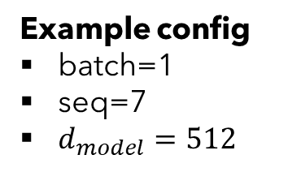





Encoder Input
Encoder Input
Positional
Encoding
$$\left(batch, seq, d_{model}\right)$$
Example config
batch=1
seq=7
$d_{model}=512$
$$\left(batch, seq, d_{model}\right)$$
$$\left(batch, seq, d_{model}\right)$$
Input Embedding
Inputs
$$\left(batch, seq\right)$$
2
9
107
550
3
1
1
"I
am
fine"
tokenizer
encodes
$$seq$$

Slide 31
Input Embedding
Example config
batch=1
seq=7
$d_{model}=512$
$$\left(batch, seq, d_{model}\right)$$
Input Embedding
Inputs
$$\left(batch, seq\right)$$
2
9
107
550
3
1
1
"I
am
fine"
tokenizer
encodes
$$seq$$

Slide 32


Input Embedding
$$d_{model}$$
… | … | … | … | …
523.415 | 1265.142 | … | 4189.251 | 16.416
452.716 | 6234.624 | … | 412.414 | 1794.127
7745.984 | 1314.124 | … | 65.764 | 1543.345
… | … | … | … | …
… | … | … | … | …
… | … | … | … | …
$$seq$$
Example config
batch=1
seq=7
$d_{model}=512$
$$\left(batch, seq, d_{model}\right)$$
Input Embedding
Inputs
$$\left(batch, seq\right)$$
2
9
107
550
3
1
1
"I
am
fine"
tokenizer
encodes
$$seq$$

Slide 34
Positional Encoding
Encoder Input
Positional
Encoding
$$\left(batch, seq, d_{model}\right)$$
Example config
batch=1
seq=7
$d_{model}=512$
$$\left(batch, seq, d_{model}\right)$$
$$\left(batch, seq, d_{model}\right)$$
Input Embedding
Inputs
$$\left(batch, seq\right)$$
2
9
107
550
3
1
1
"I
am
fine"
tokenizer
encodes
$$seq$$

Slide 35













Positional Encoding
$$d_{model}$$
$$i=0$$
$$i=1$$
$$⋯$$
$$i=d_{model}−1$$
… | … | … | … | …
PE(1,0) | PE(1,1) | … | PE(1,510) | PE(1, 511)
PE(2,0) | PE(2,1) | … | PE(2,510) | PE(2, 511)
PE(3,0) | PE(3,1) | … | PE(3,510) | PE(3, 511)
… | … | … | … | …
… | … | … | … | …
… | … | … | … | …
$$pos=0$$
$pos=$1
$$⋮$$
$$seq$$
Example config
batch=1
seq=7
$d_{model}=512$
$$pos$$
$$=seq−1$$
$$\left(batch, seq, d_{model}\right)$$
PE$\left(pos, 2i\right)=\sin\left(\frac{pos}{{10000}^{\frac{2i}{d_{model}}}}\right)$
Positional
Encoding
PE$\left(pos, 2i+1\right)=\cos\left(\frac{pos}{{10000}^{\frac{2i}{d_{model}}}}\right)$
Inputs
$$\left(batch, seq\right)$$
2
9
107
550
3
1
1
"I
am
fine"
tokenizer
encodes
$$seq$$

Slide 36
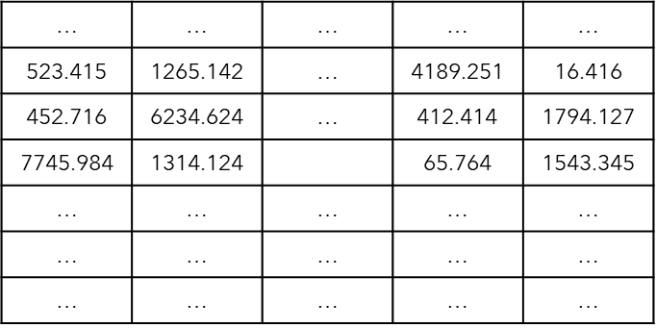
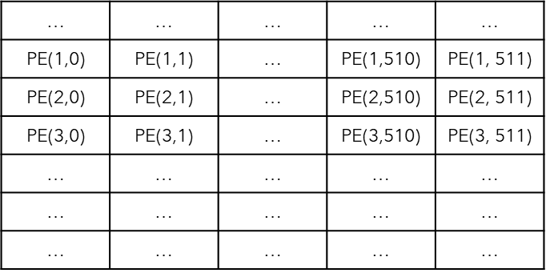




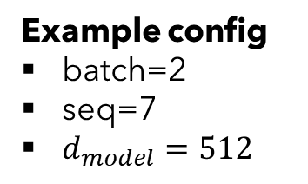





Put it all together
Encoder Input
Example config
batch=2
seq=7
$d_{model}=512$
Positional
Encoding
$$\left(batch, seq, d_{model}\right)$$
$$d_{model}$$
$$\left(batch, seq, d_{model}\right)$$
$$\left(batch, seq, d_{model}\right)$$
$$seq$$
Input Embedding
$$batch$$
Inputs
$$\left(batch, seq\right)$$
2
9
107
550
3
1
1
2
2089
95
75
120
3
1
$$batch$$
"I
am
fine"
"Thank
you
very
much"
$$seq$$

Slide 38
Encoder
Projection
Decoder
Encoder
Encoder Input
Decoder Input

Slide 39
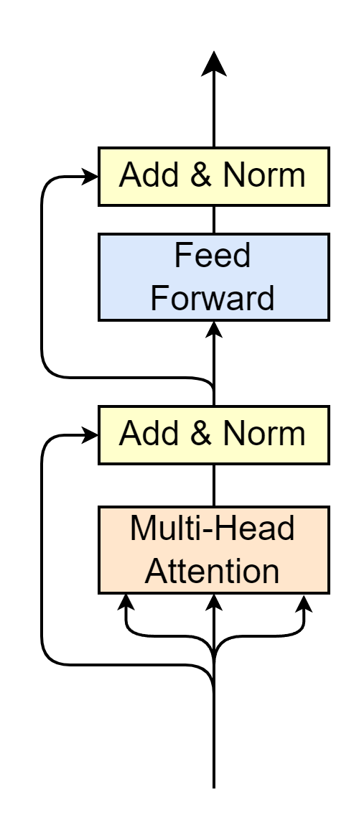
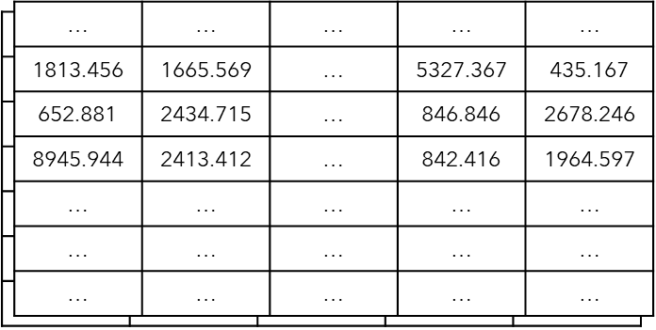



Encoder
Encoder Output
$$\left(batch, seq, d_{model}\right)$$
Multi-Head Attention
Self-Attention
Layer Normalization
Feed Forward
Residual connection
Residual Connection
$$N_{x}$$
Encoder Input
"Word meaning + position feature"
$$\left(batch, seq, d_{model}\right)$$

Slide 41
Encoder
Encoder Output
$$\left(batch, seq, d_{model}\right)$$
Multi-Head Attention
Self-Attention
Layer Normalization
Feed Forward
Residual connection
Residual Connection
$$N_{x}$$
Encoder Input
"Word meaning + position feature"
$$\left(batch, seq, d_{model}\right)$$

Slide 42
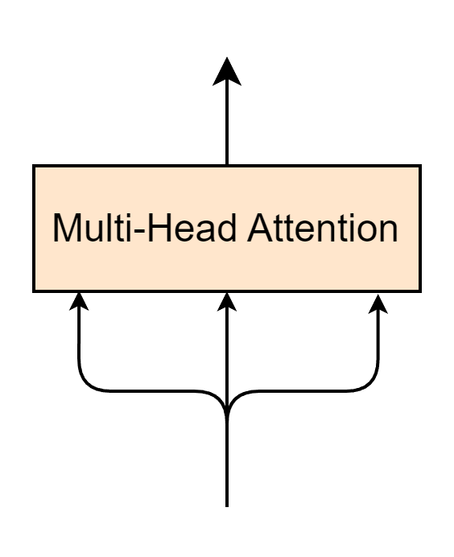








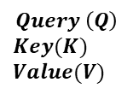
Multi-Head Attention Layer
$$\left(batch, seq, d_{model}\right)$$
$$Q$$
$$K$$
$$V$$
Encoder Input
$$Query \left(Q\right)$$
$$Key(K)$$
$$Value(V)$$
$$\left(batch, seq, d_{model}\right)$$
$$seq$$
$$≡$$
$$batch$$
$$d_{model}$$
"Word meaning + position feature"

Slide 43
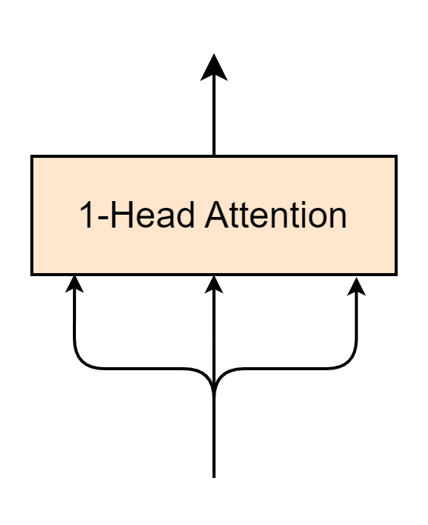
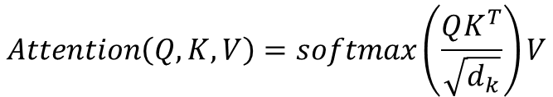
1-Head Attention Layer
$$\left(batch, seq, d_{model}\right)$$
$$Attention\left(Q, K, V\right)=softmax\left(\frac{QK^{T}}{\sqrt{d_{k}}}\right)V$$
$$Q$$
$$K$$
$$V$$
Encoder Input
$$\left(batch, seq, d_{model}\right)$$

Slide 44
1-Head Attention Layer – Self Attention
Self-Attention
$$\left(batch, seq, d_{model}\right)$$
$$Attention\left(Q, K, V\right)=softmax\left(\frac{QK^{T}}{\sqrt{d_{k}}}\right)V$$
$$Q$$
$$K$$
$$V$$
Encoder Input
$$\left(batch, seq, d_{model}\right)$$

Slide 45

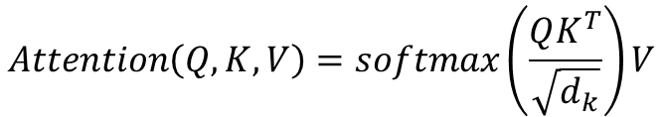






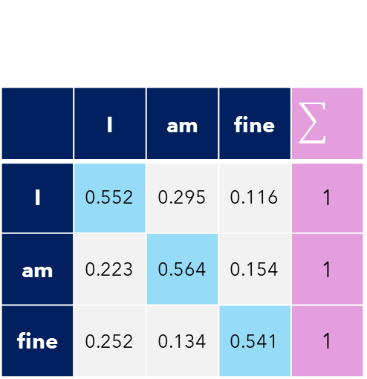

Self-Attention
Self-Attention
Example config
batch=1
seq=3
$d_{model}=d_{k}=512$
$$Attention\left(Q, K, V\right)=softmax\left(\frac{QK^{T}}{\sqrt{d_{k}}}\right)V$$
$$K^{T}(512,3)$$
$$Q(3, 512)$$
1813.456 | 652.881 | 8945.944
1665.569 | 2434.715 | 2413.412
… | … | …
5327.367 | 846.846 | 842.416
435.167 | 2678.246 | 1964.597
Self-Attention$(3,3)$
1813.456 | 1665.569 | … | 5327.367 | 435.167
652.881 | 2434.715 | … | 846.846 | 2678.246
8945.944 | 2413.412 | … | 842.416 | 1964.597
$$×$$
 | I | am | fine
I | 0.552 | 0.295 | 0.116 | 1
am | 0.223 | 0.564 | 0.154 | 1
fine | 0.252 | 0.134 | 0.541 | 1
$$softmax$$
$$=$$
$$\sqrt{512}$$
Self-attention -> Relate words to each others

Slide 46






1-Head Attention Layer
1-Head Attention
Self-Attention
Example config
batch=1
seq=3
$d_{model}=d_{k}=512$
$$Attention\left(Q, K, V\right)=softmax\left(\frac{QK^{T}}{\sqrt{d_{k}}}\right)V$$
Self-Attention$(3,3)$
 | I | am | fine
I | 0.552 | 0.295 | 0.116 | 1
am | 0.223 | 0.564 | 0.154 | 1
fine | 0.252 | 0.134 | 0.541 | 1
V$(3, 512)$
Attention$(3, 512)$
1813.456 | 1665.569 | … | 5327.367 | 435.167
652.881 | 2434.715 | … | 846.846 | 2678.246
8945.944 | 2413.412 | … | 842.416 | 1964.597
… | … | … | … | …
… | … | … | … | …
… | … | … | … | …
$$×$$
$$=$$
"Word meaning + position feature"
"Word meaning + position feature"
"Relate words to each others"
"Relate words to each others"

Slide 47
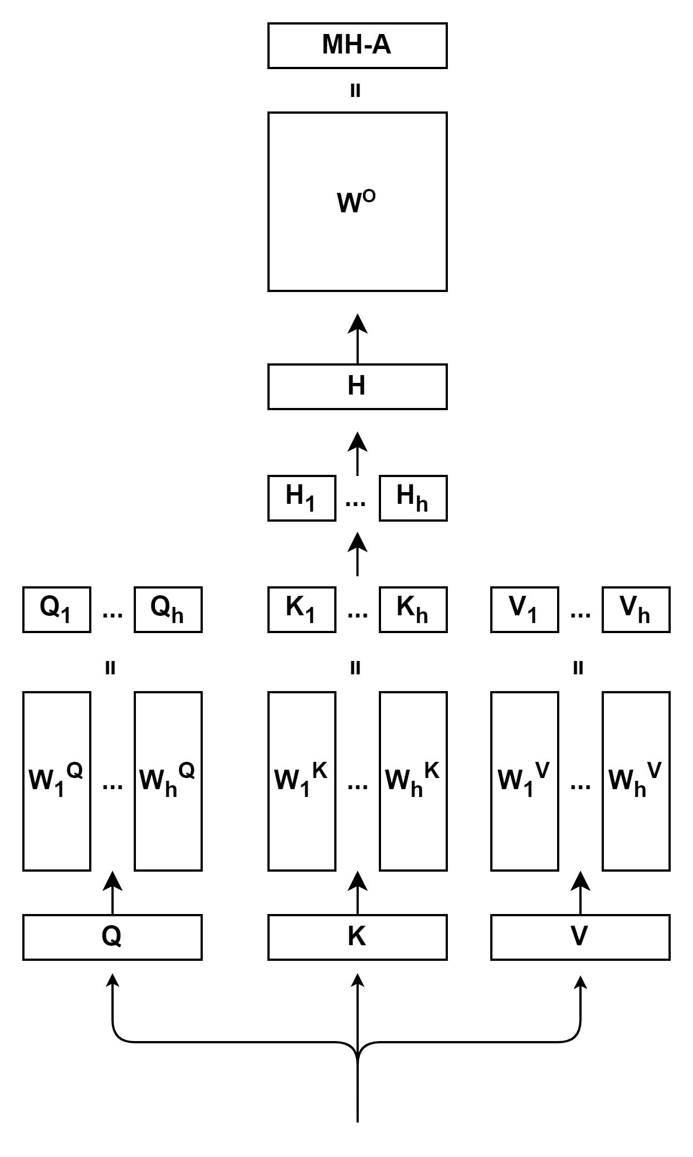
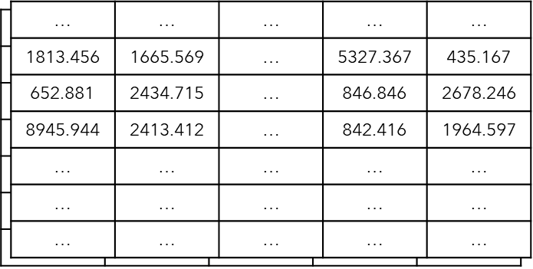

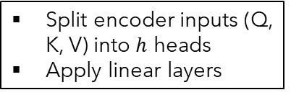








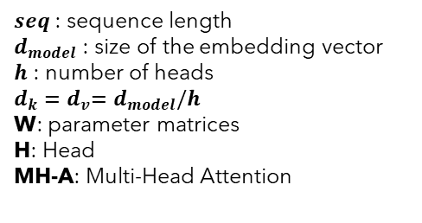





Multi-Head Attention
$$\left(batch, seq, d_{model}\right)$$
$seq$ : sequence length
$d_{model}$ : size of the embedding vector
$h$ : number of heads
$d_{k}{=d}_{v}=d_{model}/h$
W: parameter matrices
H: Head
MH-A: Multi-Head Attention
$$×$$
$$\left(batch,d_{model}, d_{model}\right)$$
Apply linear layer
$$\left(batch, seq, d_{model}\right)$$
$$Concat\left(head_{1},⋯,head_{h}\right)$$
$$\left(batch, seq, d_{v}\right)$$
$${Head}_{i}=Attention\left(QW_{i}^{Q},KW_{i}^{K},VW_{i}^{V}\right)$$
$$Attention\left(Q, K, V\right)=softmax\left(\frac{QK^{T}}{\sqrt{d_{k}}}\right)V$$
$$\left(batch, seq, d_{k}\right)$$
$$×$$
$$\left(batch,d_{model}, d_{k}\right)$$
Split encoder inputs (Q, K, V) into $h$ heads
Apply linear layers
$$batch$$
$$d_{model}$$
$$\left(batch, seq, d_{model}\right)$$
$$seq$$
Encoder Input
$$\left(batch, seq, d_{model}\right)$$

Slide 49

Encoder
Encoder Output
$$\left(batch, seq, d_{model}\right)$$
Multi-Head Attention
Self-Attention
Layer Normalization
Feed Forward
Residual connection
Residual Connection
$$N_{x}$$
Encoder Input
$$\left(batch, seq, d_{model}\right)$$

Slide 50
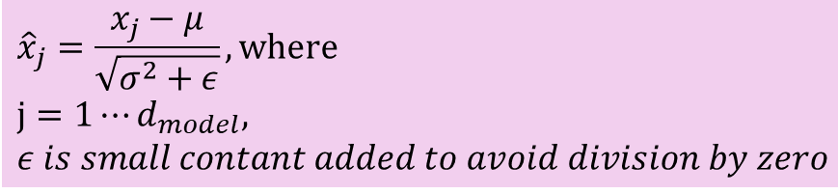

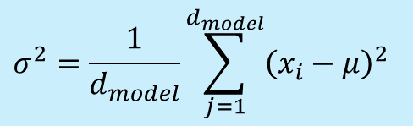





Layer Normalization
Given a token, using embedding we obtain the its feature vector with length of $d_{model}$
Calculate mean
Calculate variance
Normalization
$$x_{1}$$
$$x_{d_{model}}$$
 |  | …
$$μ=\frac{1}{d_{model}}\sum_{j=1}^{d_{k}}{x_{j}}$$
$$σ^{2}=\frac{1}{d_{model}}\sum_{j=1}^{d_{model}}{{\left(x_{i}−μ\right)}^{2}}$$
$${\hat{x}}_{j}=\frac{x_{j}−μ}{\sqrt{σ^{2}+ε}}, where$$
$$j=1⋯d_{model},$$
$ε is small contant added to avoid division by zero$
$${\hat{x}}_{i,1}$$
$${\hat{x}}_{{i,d}_{model}}$$
 |  | …

Slide 51
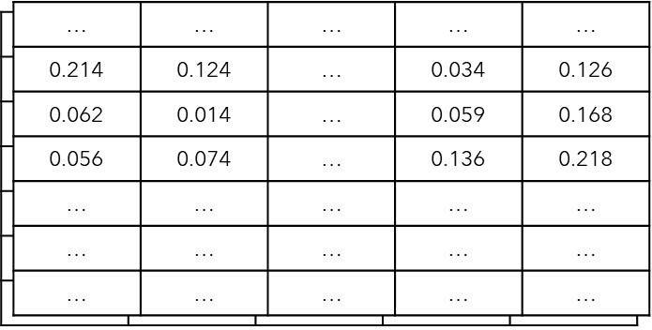
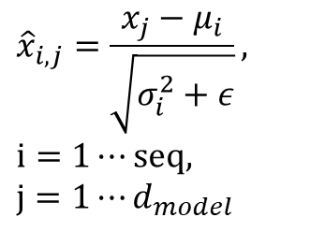


Put it all together
$$\left(batch, seq,d_{model}\right)$$
$${\hat{x}}_{i,j}=\frac{x_{j}−μ_{i}}{\sqrt{σ_{i}^{2}+ε}},$$
$$i=1⋯seq,$$
$$j=1⋯d_{model}$$
Layer Normalization
$$\left(batch, seq,d_{model}\right)$$
$$batch$$
$$seq$$
$$d_{model}$$

Slide 53
Encoder
Encoder Output
$$\left(batch, seq, d_{model}\right)$$
Multi-Head Attention
Self-Attention
Layer Normalization
Feed Forward
Residual connection
Residual Connection
$$N_{x}$$
Encoder Input
$$\left(batch, seq, d_{model}\right)$$

Slide 54
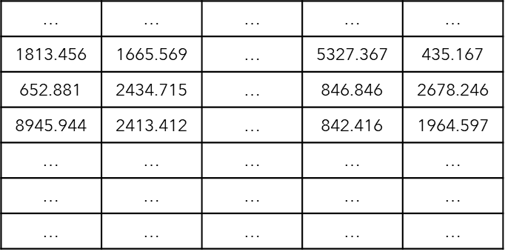



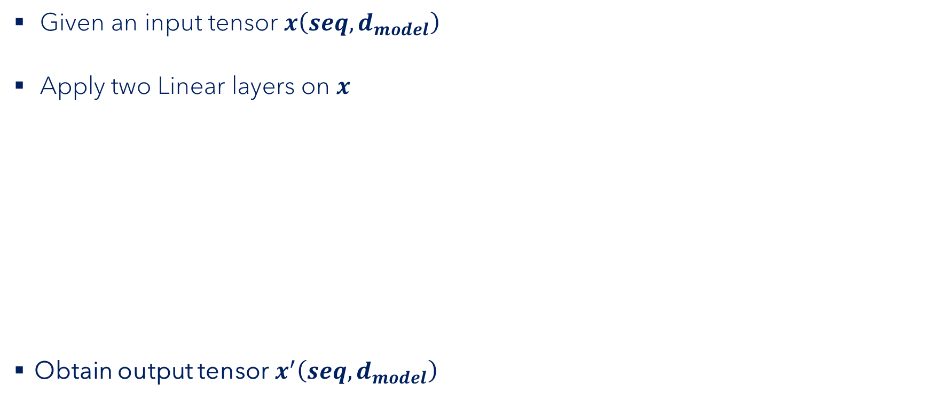















Feed Forward
$$seq$$
Given an input tensor $x\left(seq,d_{model}\right)$
Apply two Linear layers on $x$
Obtain output tensor$x^{′}\left(seq,d_{model}\right)$
$$d_{model}$$
$$x^{′}=FF\left(x\right)=ReLU\left(x{×W}_{1}+b_{1}\right)×W_{2}+b_{2} , where ReLU\left(x\right)=max(0,x)$$
$$W_{1}$$
$$W_{2}$$
$$FF\left(x\right)=$$
$$x$$
$$×$$
$$+$$
$$b_{1}$$
$$×$$
$$+$$
$$b_{2}$$
$$ReLU$$
$$\left(seq,d_{model}\right)$$
$$\left(d_{ff},d_{model}\right)$$
$$\left(d_{model},d_{ff}\right)$$
$$Linear layer 1 \left(seq,d_{ff}\right)$$
$$Linear layer 2 \left(seq,d_{model}\right)$$

Slide 56
Encoder
Encoder Output
$$\left(batch, seq, d_{model}\right)$$
Multi-Head Attention
Self-Attention
Layer Normalization
Feed Forward
Residual connection
Residual Connection
$$N_{x}$$
Encoder Input
$$\left(batch, seq, d_{model}\right)$$

Slide 57






Residual Connection
$$x^{′}$$
$$+$$
Given an input tensor $x$, and a residual connection
Sublayers can be
Feed Forward
Multi-head Attention
…
Obtain the output tensor $x^{′}$
$$Sublayer$$
$$x$$
$$x^{′} =x+sublayer(x)$$

Slide 59

Encoder
Encoder Output
$$\left(batch, seq, d_{model}\right)$$
Multi-Head Attention
Self-Attention
Layer Normalization
Feed Forward
Residual connection
Residual Connection
$N_{x}$=6
Encoder Input
$$\left(batch, seq, d_{model}\right)$$

Slide 61
Decoder
Projection
Decoder
Encoder
Encoder Input
Decoder Input

Slide 62
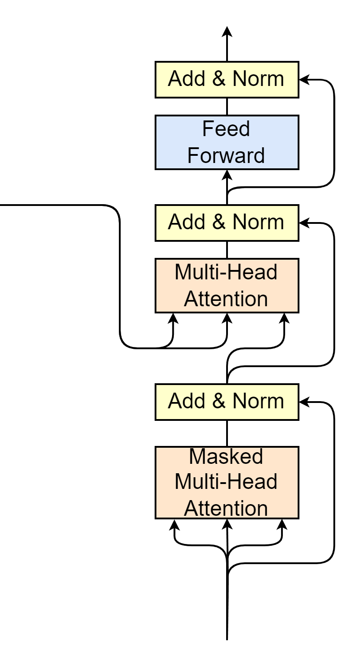









Decoder
Decoder Input
$$\left(batch, seq_{de}, d_{model}\right)$$
Most blocks as same as those in Encoder part, except
Multi-head Attention
Masked Multi-head Attention
Multi-Head Attention
$K$ and $V$ come from encoder output
$Q$ comes from decoder's previous blocks
Masked Multi-Head Attention
$seq_{de}$
Training: $seq_{de}=seq$
Inference: $seq_{de}$ : from 1 to $seq$
Encoder Output
$$\left(batch, seq, d_{model}\right)$$
$$K$$
$$V$$
$$Q$$
$$N_{x}$$
$$\left(batch, seq_{de}, d_{model}\right)$$
Decoder Input
$$\left(batch, seq_{de}, d_{model}\right)$$

Slide 63


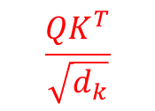
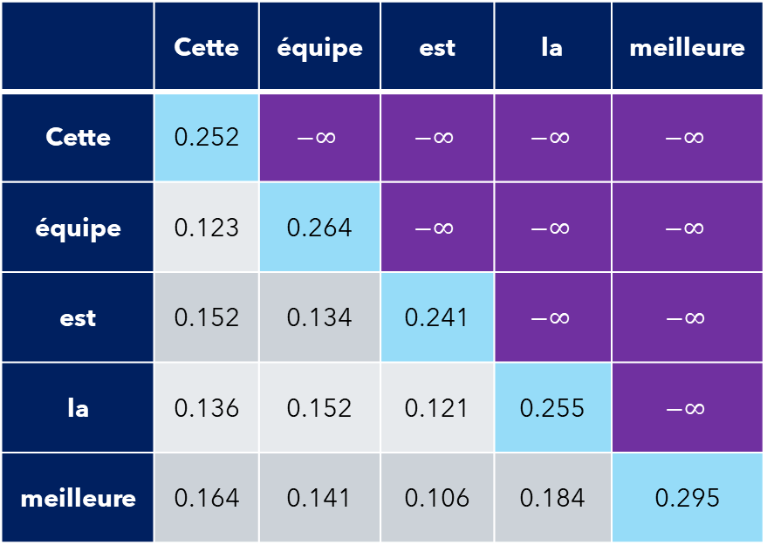
Masked Multi-Head Attention
$$Attention\left(Q, K, V\right)=softmax\left(\frac{QK^{T}}{\sqrt{d_{k}}}\right)V$$
Self-attention
$$\frac{QK^{T}}{\sqrt{d_{k}}}$$
Apply mask matrix
Each word only correlates with previous words
 | Cette | équipe | est | la | meilleure
Cette | 0.252 | $$−∞$$ | $$−∞$$ | $$−∞$$ | $$−∞$$
équipe | 0.123 | 0.264 | $$−∞$$ | $$−∞$$ | $$−∞$$
est | 0.152 | 0.134 | 0.241 | $$−∞$$ | $$−∞$$
la | 0.136 | 0.152 | 0.121 | 0.255 | $$−∞$$
meilleure | 0.164 | 0.141 | 0.106 | 0.184 | 0.295
 | Cette | équipe | est | la | meilleure
Cette | 1.0 | 0 | 0 | 0 | 0
équipe | 0.465 | 0.525 | 0 | 0 | 0
est | 0.325 | 0.319 | 0.356 | 0 | 0
la | 0.242 | 0.246 | 0.239 | 0.273 | 0
meilleure | 0.197 | 0.192 | 0.186 | 0.201 | 0.224
$$softmax$$

Slide 64
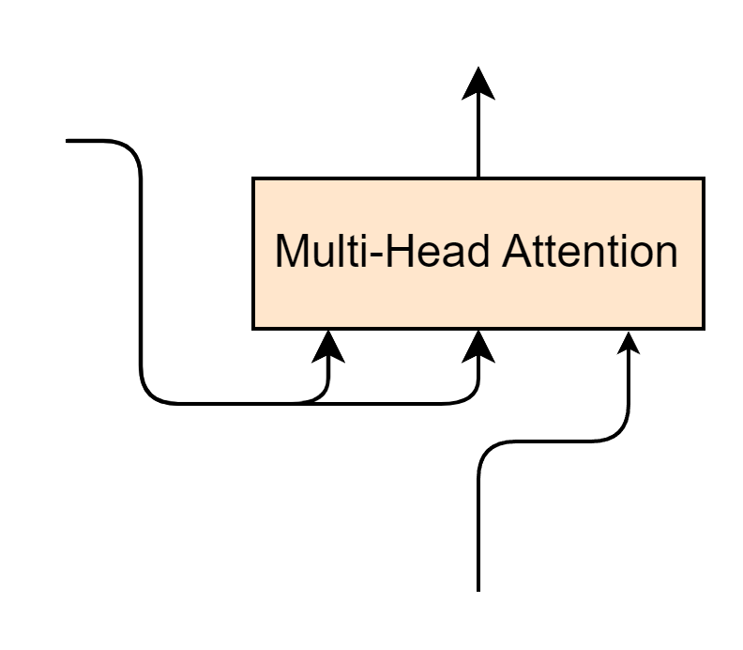




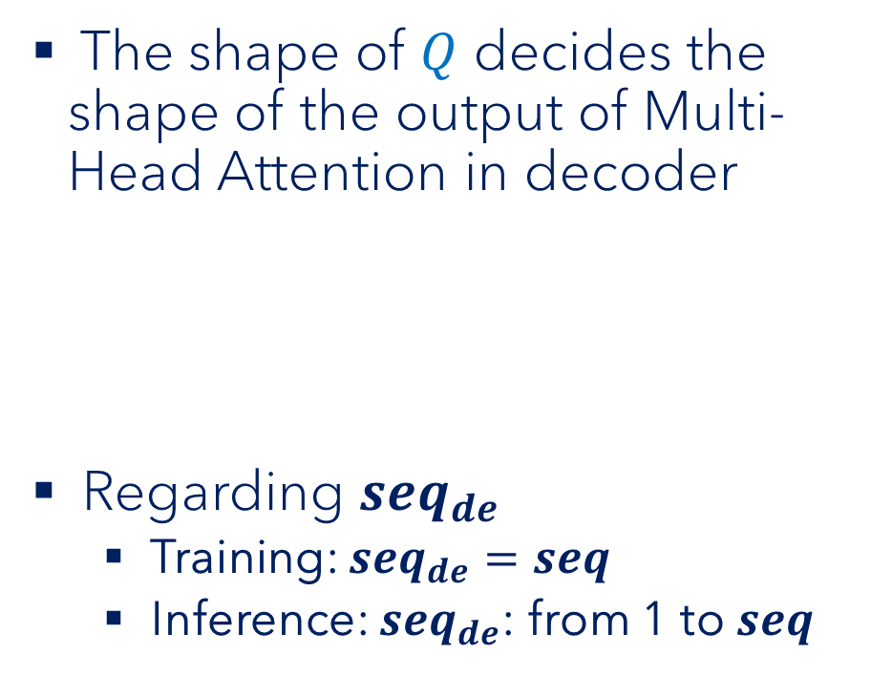



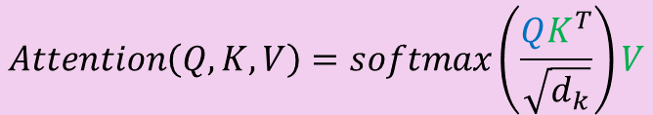



Multi-Head Attention of Decoder
The shape of $Q$ decides the shape of the output of Multi-Head Attention in decoder
Regarding $seq_{de}$
Training: $seq_{de}=seq$
Inference: $seq_{de}$: from 1 to $seq$
$$\left(batch, seq_{de}, d_{model}\right)$$
Encoder Output
$$\left(batch, seq, d_{model}\right)$$
$$K$$
$$V$$
$$Q$$
$$Q$$
$$K^{T}$$
$$V$$
$$\left(\left(seq_{de}, d_{model}\right)×\left(d_{model},seq\right)\right)×(seq, d_{model})$$
$$\left(seq_{de}, d_{model}\right)$$
$$\left(batch, seq_{de}, d_{model}\right)$$
$$Attention\left(Q, K, V\right)=softmax\left(\frac{QK^{T}}{\sqrt{d_{k}}}\right)V$$

Slide 65



Decoder
Decoder Output
$$\left(batch, seq, d_{model}\right)$$
Multi-Head Attention
Masked Multi-Head Attention
Encoder Output
$$\left(batch, seq, d_{model}\right)$$
$$K$$
$$V$$
$$Q$$
$N_{x}$=6
Decoder Input
$$\left(batch, seq_{decoder}, d_{model}\right)$$

Slide 67
Transformer Output
Projection
Linear layer
Softmax
Projection
Decoder
Encoder
Encoder Input
Decoder Input

Slide 68
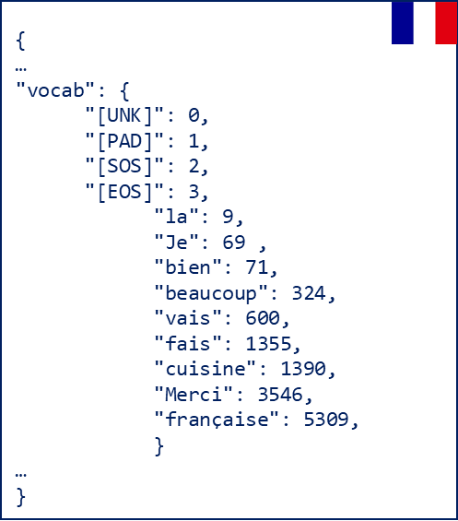



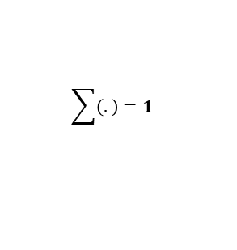











Transformer output
Target Tokenizer
Je
Given a decoder output $x\left(batch, seq_{de},d_{model}\right)$
The Linear layer projects $x$ to $x^{′}\left(batch, seq_{de},vocal_{size} \right)$
decode
$$vocal_size=10000$$
$$idx=69$$
0.03 | 0.04 | … | … | 0.86 | ... | … | … | … | 0.04
$$\sum{\left(.\right)}=1$$
$$softmax$$
3.42 | 4.65 | … | … | 86.45 | ... | … | … | … | 4.15
$$W$$
$$vocal_size=10000$$
$$Linear\left(x\right)=$$
$$x$$
$$×$$
$$+$$
$$b$$
Linear
$$\left(d_{model},vocal_size\right)$$
214.241 | 421.145 | … | 102.541 | 312.264
$$\left(seq_{de},d_{model}\right)$$
$$d_{model}=512$$

Slide 70

Now take a bow!
Projection
Decoder
Great job!
Encoder
Encoder Input
Decoder Input

Slide 72
Training
Target:
"Je vais bien"
t1
Je vais bien <EOS>
Cross Entropy Loss
X Y Z
Decoder
Encoder
Update model parameters
<SOS> I am fine <EOS>
<SOS> Je vais bien
Source:
Target:
"I am fine"
"Je vais bien"

Slide 73
Training
Target:
"Je t'aime"
t2
Je t'aime <EOS>
Cross Entropy Loss
A B C
Decoder
Encoder
Update model parameters
<SOS> I love you<EOS>
<SOS> Je t'aime
Source:
Target:
"I love you"
"Je t'aime"

Slide 75
Inference
t1
Je
Decoder
Encoder
<SOS> I am fine <EOS>
<SOS>
Source:
"I am fine"

Slide 76
Inference
t2
Je
Decoder
Encoder
<SOS> I am fine <EOS>
<SOS>
Source:
"I am fine"

Slide 77
Inference
t2
vais
Decoder
Encoder
<SOS> I am fine <EOS>
<SOS> Je
Source:
"I am fine"

Slide 78
Inference
t3
vais
Decoder
Encoder
<SOS> I am fine <EOS>
<SOS> Je
Source:
"I am fine"

Slide 79
Inference
t3
bien
Decoder
Encoder
<SOS> I am fine <EOS>
<SOS> Je vais
Source:
"I am fine"

Slide 80
Inference
t4
bien
Decoder
Encoder
<SOS> I am fine <EOS>
<SOS> Je vais
Source:
"I am fine"

Slide 81
Inference
t4
Prediction:
"Je vais bien"
EOS
Decoder
Encoder
<SOS> I am fine <EOS>
<SOS> Je vais bien
Source:
"I am fine"

